Slide 1
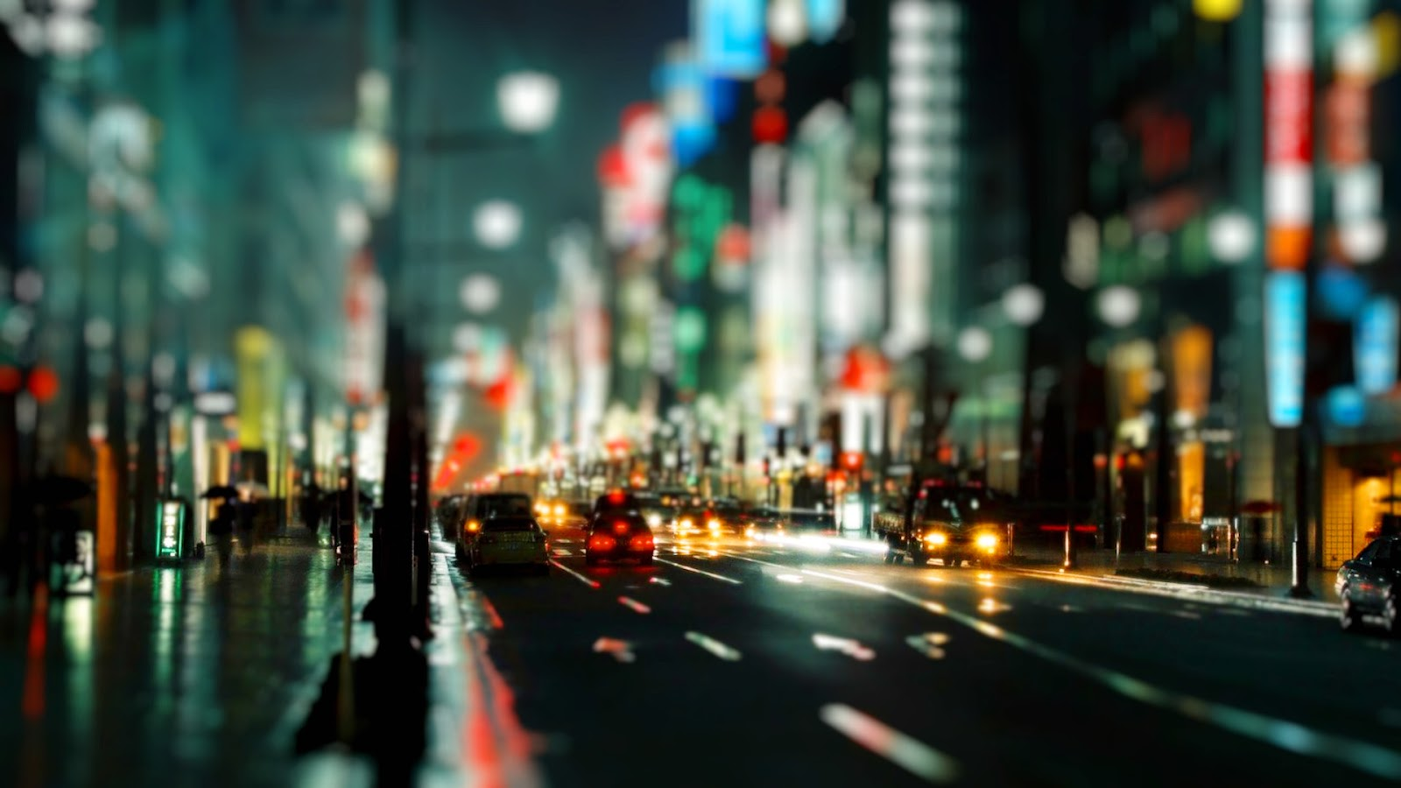
Exploring Bangalore
Final presentation
For
Applied data-science capstone
By
Sudeshna Sen
07-03-2020
Helping clients find the best neighbourhood in the city

Slide 2
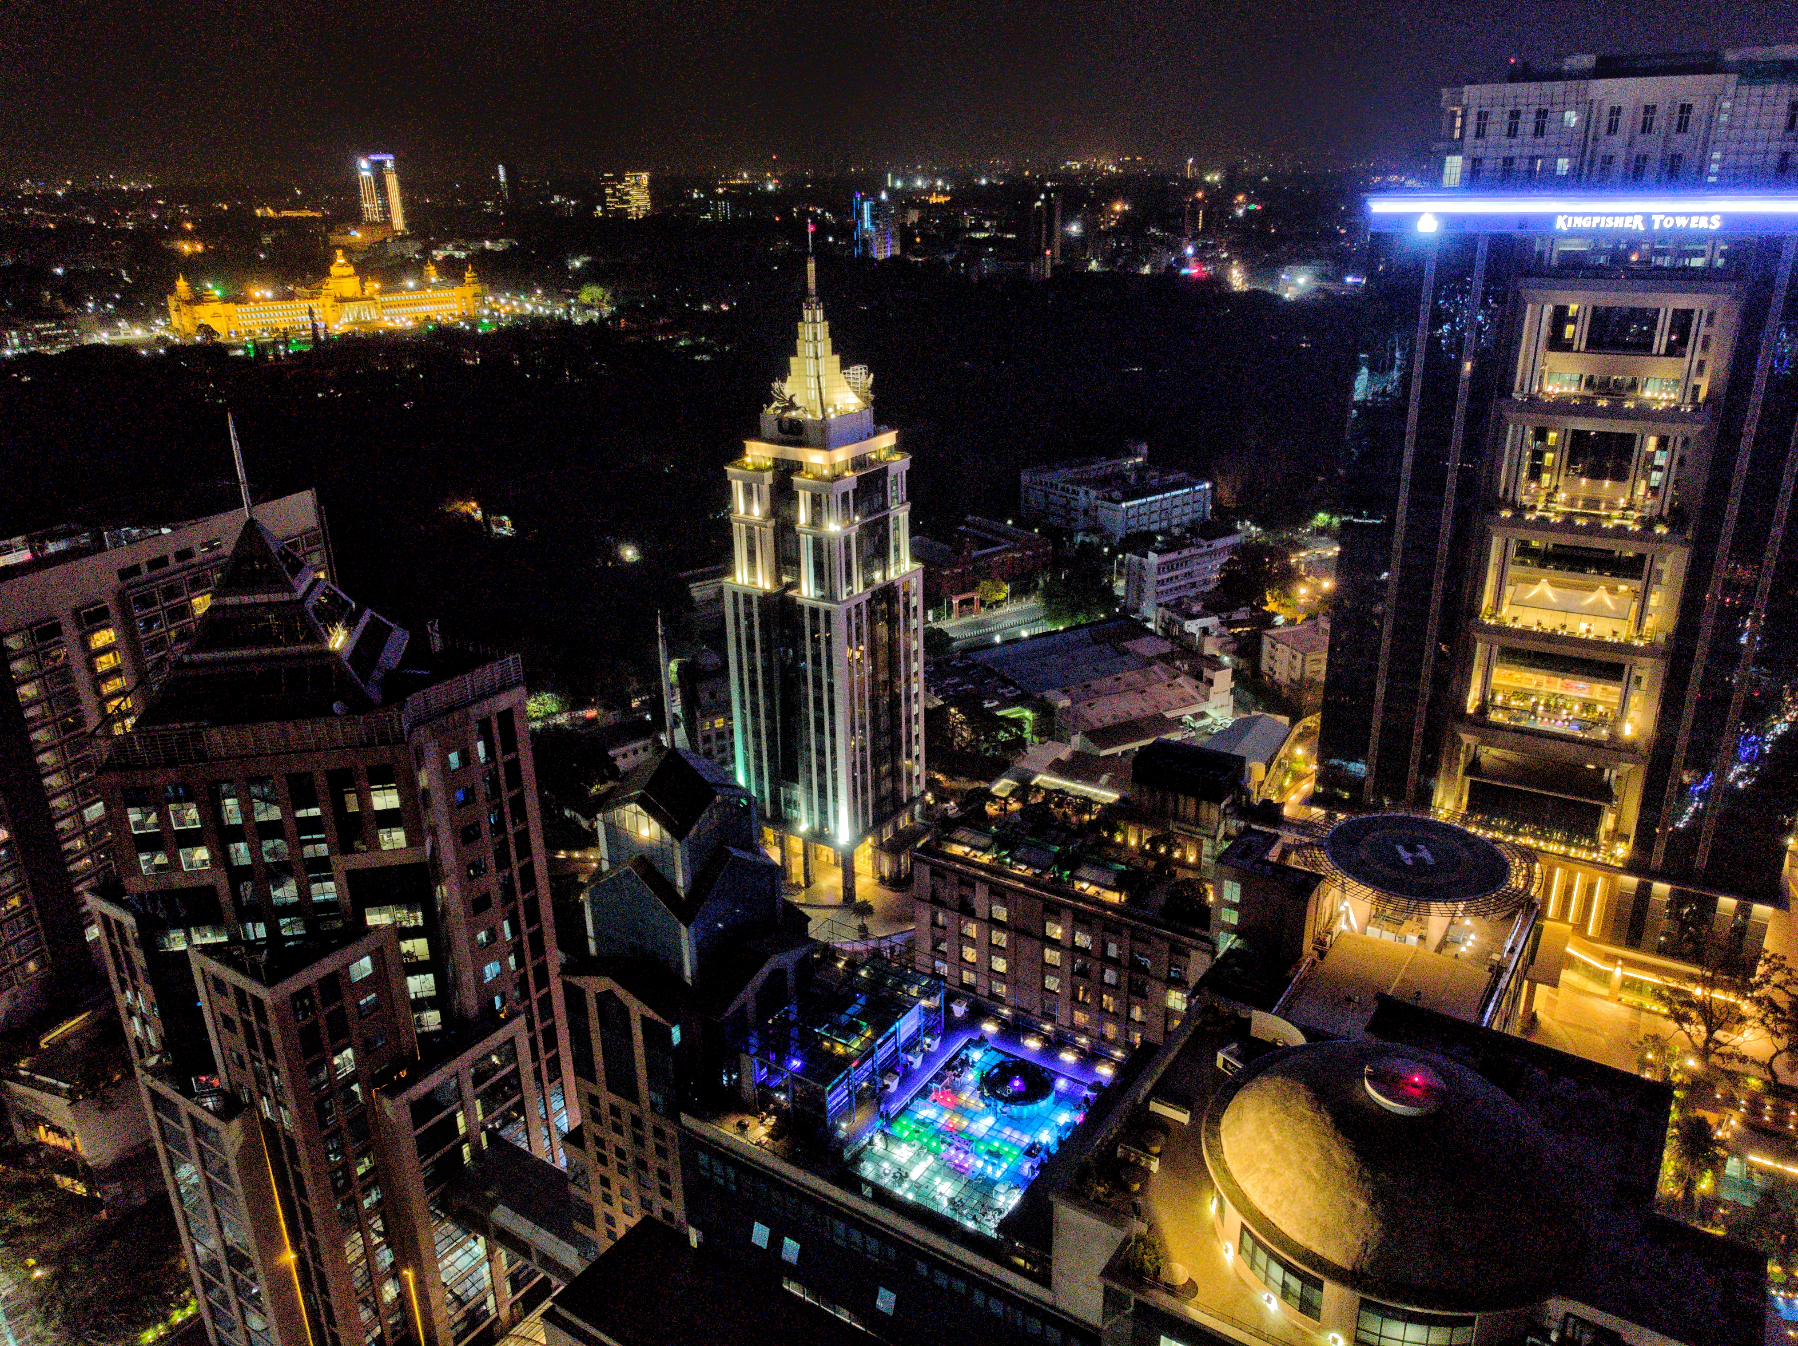
Facts & Figures
The city of Bangalore is one of the cities with the highest growing populations of India. This is because it is the IT hub and the Silicon valley of India with thousands of people flocking to this city each year in search of jobs.
Population : 12.5 million
Area : 709 km²
Population Density : 12,000/km²
Official language : Kannada

Slide 3
problem
Finding the correct locality might become a mammoth task for someone who is not familiar with the city.
Rental rates vary from region to region in Bangalore and may depend on several factors like connectivity, location, amenities, etc.
Currently several apps help users search for a good apartment in a particular area but none of them include proper information about the neighbourhood.
Apartment hunting for people who are new to Bangalore is difficult.

Slide 4
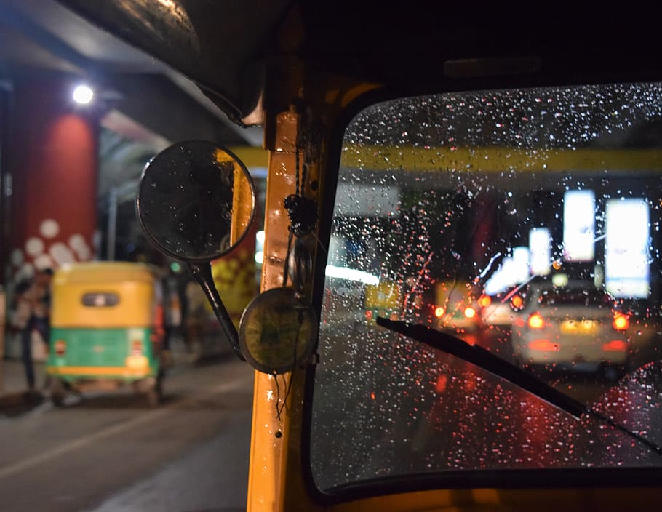




SOLUTION
Data Required
Geospatial data
Rental rates
Venues
We need accurate data of latitudes and longitudes of all neighborhoods in the city
We also need data for the rental rates of apartments in these regions
We would also require the list of venues (shops, cafes, restaurants, gyms, etc.) in each neighborhood.
Clustering neighborhoods based on Rental rates and venues

Slide 5
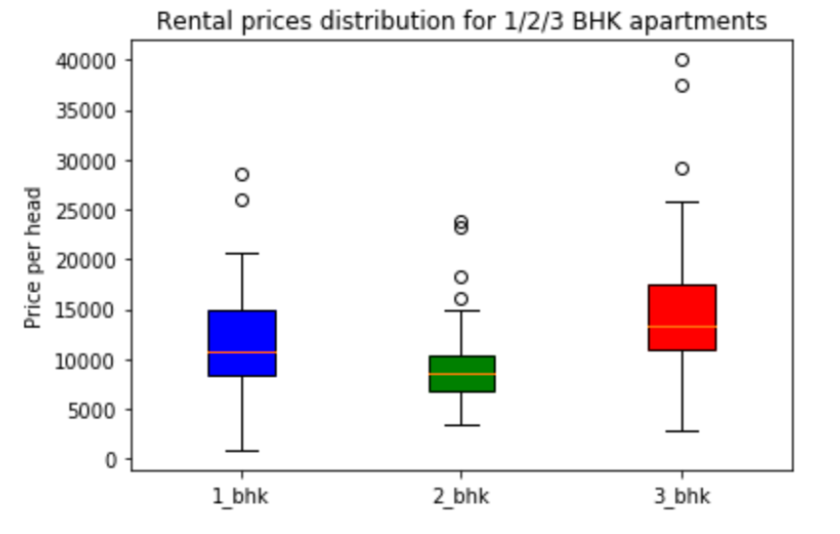
Analysis
VERDICT: Going for a 2BHK is the most pocket friendly option in most areas.
Rates for different types of apartments
Data collected needs to be thoroughly examined before clustering

Slide 6
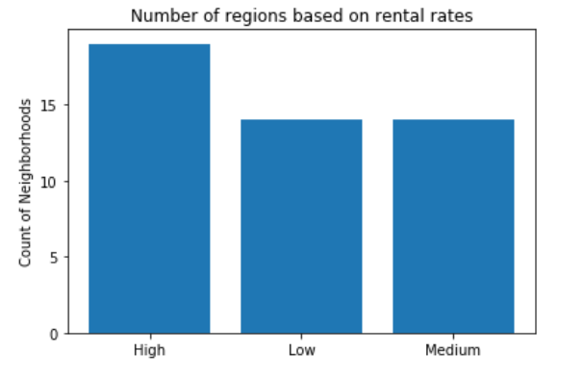
Analysis
VERDICT: The rent is pretty high in most parts of the city. This is understandable due to the rising demands and shortage of apartments in Bangalore.
Count of regions based on rates
Data collected needs to be thoroughly examined before clustering

Slide 7
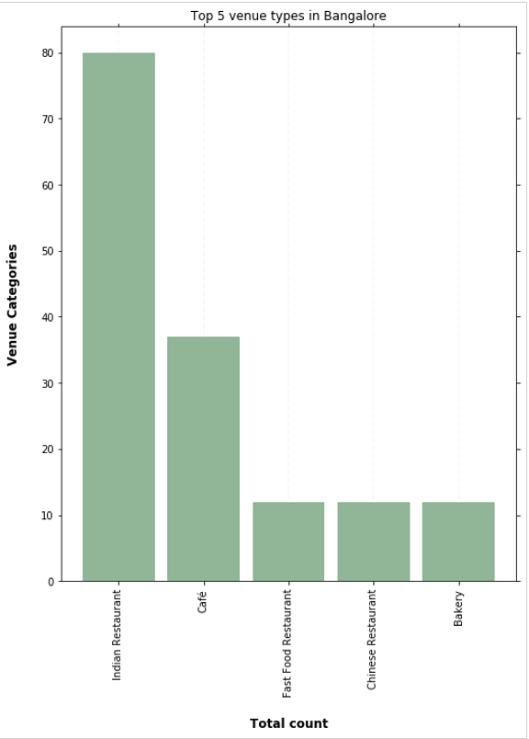
Analysis
VERDICT: The city is a heaven for foodies with the top venues being restaurants, cafes and bakeries.
Top categories of venues
Data collected needs to be thoroughly examined before clustering

Slide 8
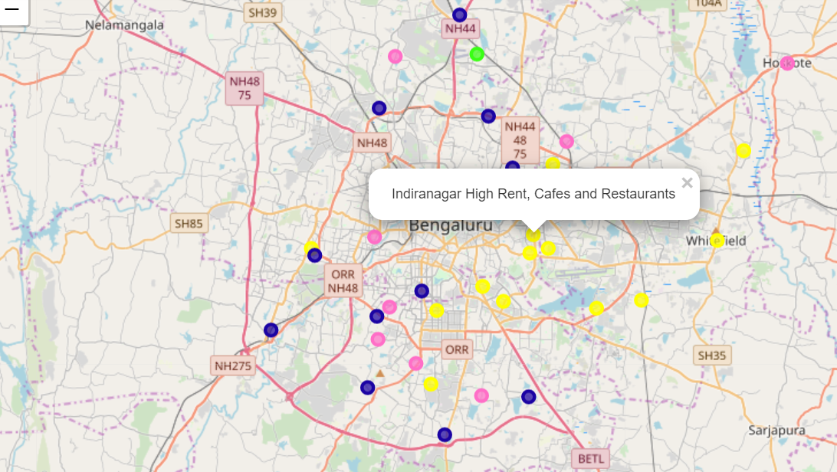
Clustering
High Rent, Cafes and Restaurants
Low rent, Local Restaurants and stores
Medium rent, Mixed Restaurants and stores
High rent, ATMs
Visualizing the clusters
Neighbourhoods clustered into four groups:
Clustering technique used was k-means clustering

Slide 9
results
Advantages:
Venues
Rental rates
Neighbour hoods
Best neighbourhood selection according to individual needs
More information
Unlike traditional property sites and apps, this project will provide users additional details about the region i.e. the venues.
Visual clues
The clusters being visualized on a map will allow users to choose the best location based on proximity to their workplace.
Side by side comparison
All the regions are laid out on a single map which eliminated the need for the user to separately filter by regions to choose the best one.
Clustered neighborhoods will allow clients to make better decisions

Slide 10
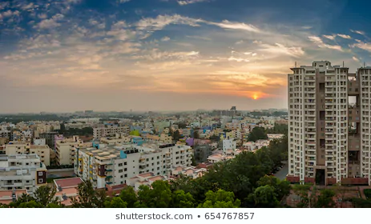



Challenges
Unavailability of data
Incorrect data
Paid API calls
Some of the data obtained for the neighborhoods were incorrect . Because the sources of this data is restricted, the data had to be treated and cleansed manually.
Web scraping was blocked for most of the property apps and the APIs for some of the popular apps required paymen for API calls.
Most of the data for regions in India exist till the district level. To get data of greater granularity proved to be challenging.
Roadblocks faced in the process of data collection.

Slide 11



Further scope
More venues
Transportation data
Security
Availability of more data on venues, preferably related to amenities like hospitals, schools, etc. will allow users to make better judgements
This project can be greatly improved if we can leverage data related to connectivity in a particular area like public transport, routes, fares, etc.
The safety and security of a locality is of prime importance while hunting for apartments. The crime data of regions can be leveraged for this.
This project leaves a lot of scope for future developments to create better clusters.

Slide 12
Thank You

